Slide 1

Our Smoky Mountain History
Artifacts
and their
significance

Slide 2

Our Goal For Today
Today we’re going to be learning about the people who lived in the area that is now Great Smoky Mountains National Park. This helps us understand where the people who lived here before us came from, what they did, and how they lived.
When we know our history, we can feel proud of our cultural identity. It also helps us appreciate and understand other people's cultures, and why they do things differently.
By learning about our history, we can keep our traditions and stories alive, and share them with others.

Slide 3

What if my family isn’t from here originally?
You’re still part of Smoky Mountain history because you live here now!
One day the things that you use in your daily life or your pictures might be artifacts that tell the story of what life was like in the mountains of Western North Carolina today!
Someday people will try to understand you by studying the music, dances, tv shows, movies, and books you like now!

Slide 4

Instructions
With your group, look at your artifact and try to answer the Five W’s about your artifact!
The "Five W's" are who, what, when, where, and why.

Slide 5

Who?
This question helps us learn about the people involved in something. For example, “Who used or made the artifact or is in the picture?”

Slide 6

What?
This question helps us learn about what happened, or what something is. For example, “What was the artifact used for, or what is going on in the picture?”

Slide 7

When?
This question helps us learn about when something happened. For example, “When is the artifact from, or when was the picture taken?”

Slide 8

Where?
This question helps us learn about where something happened or where something is located. For example, “Where did the artifact come from, or where was the picture taken?”

Slide 9

Why?
This question helps us learn about the reason behind something or why something happened. For example, “Why does this artifact relate to the people who used to live in the Great Smoky Mountains National Park?”

Slide 10
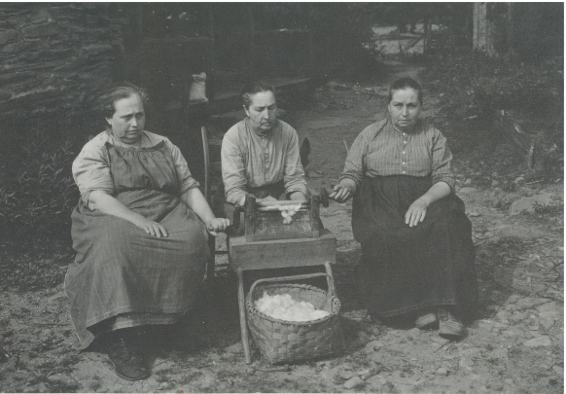
Artifact One

Slide 11
The Walker Sisters
The Walker sisters were a group of seven sisters who lived in the Great Smoky Mountains in what is now the national park. They were born and raised on a 120-acre farm in what was then known as Little Greenbrier Cove, near the town of Gatlinburg, Tennessee.
The sisters - Margaret, Polly, Martha, Louisa, and Hettie - were known for their self-sufficiency and isolation from the modern world. They lived without electricity or running water, and their farm was accessible only by footpath. They made their living by farming, raising livestock, and selling handmade crafts, such as baskets, quilts, and dolls.
Three of the Walker sisters: Hettie Walker, Martha Walker, and Louisa Walker

Slide 12
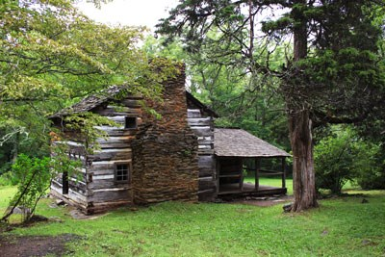
The Walker Sisters’ Home
Their lifestyle and story caught the attention of the national park officials in the 1940s, as the government began acquiring land for what would become the Great Smoky Mountains National Park. The Walkers refused to sell their land, and the government eventually allowed them to remain on the property under a special use permit.
The Walker sisters gained fame as a result of their unique lifestyle and the attention they received from the media. They were featured in newspapers and magazines, and even appeared on television programs like "The Today Show."
In 1964, the last surviving Walker sister, Louisa, passed away. Their home and property were donated to the national park, and today visitors can see the restored Walker Sisters Cabin and learn about the sisters and their way of life through exhibits and programs.
The Walker sisters' home sits just over a mile back in the woods from the Little Greenbrier Schoolhouse.

Slide 13
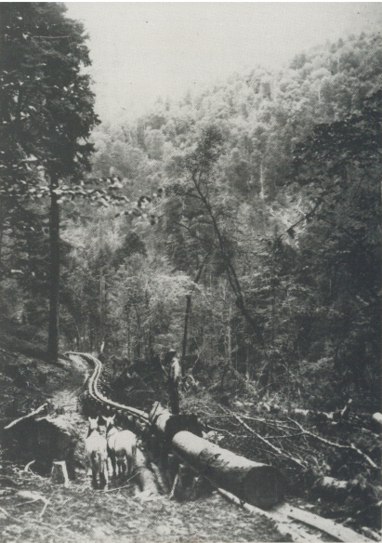
Artifact Two

Slide 14
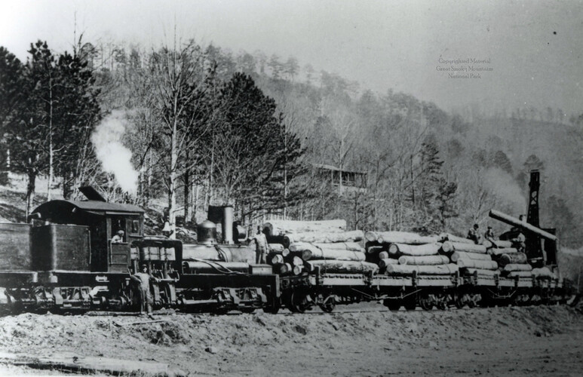
Logging in the Smokies
In the early 1900s, the Great Smoky Mountains region was heavily forested with vast stands of valuable timber, including hardwoods like oak and poplar, and softwoods like hemlock and spruce. The lumber industry was expanding rapidly across the United States, and the Great Smoky Mountains were seen as a prime area for timber extraction.
Logging companies began to move into the area, building railroads and logging camps in the remote mountain valleys. They employed thousands of workers, many of whom were immigrants, to fell trees and haul logs out of the forest. The logging camps were often located far from towns and cities, and workers lived in primitive conditions, enduring long hours and dangerous work.
Logging: Logs Loaded On Train c. 1925

Slide 15
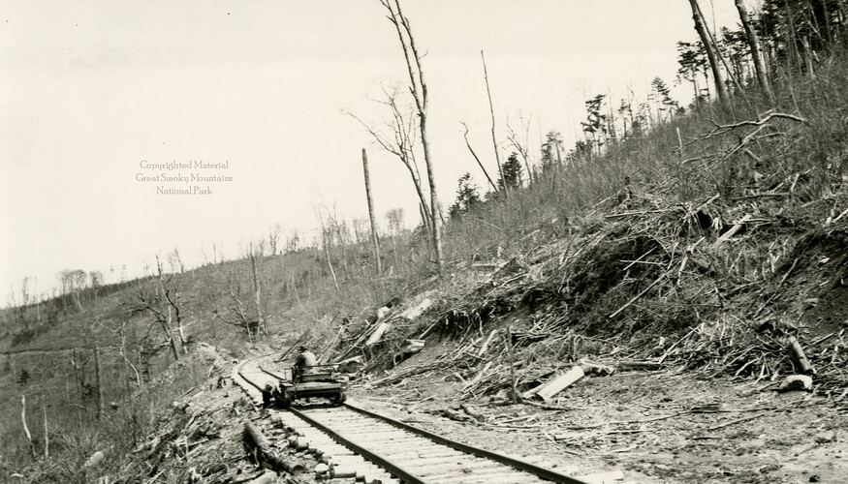
Impact of Logging
The impact of logging on the forests of the Great Smoky Mountains was severe. The clear-cutting of entire forests left the land barren and vulnerable to erosion, leading to soil depletion and flooding in downstream areas. The logging also disrupted the natural habitats of many species of plants and animals, causing long-lasting ecological damage.
By the 1920s, concerns about the environmental and economic impacts of logging in the Great Smoky Mountains were mounting. The forested slopes of the mountains had become a patchwork of clear-cuts, and many feared that the timber industry was destroying one of the country's most valuable natural resources. In response, the government began to acquire land in the area, with the goal of creating a national park that would preserve the region's natural beauty and wildlife.

Slide 16

Cataloochee Logging
A 33,000-acre tract of land in Cataloochee was owned by Suncrest Lumber Company. While many believe that the Great Smoky Mountains was made up of small family farms, in reality, 18 lumber companies together owned about 85 percent of the proposed park area. One of these was Suncrest, which timbered thousands of acres in Cataloochee and operated a mill in nearby Waynesville, North Carolina.
After most logging operations ceased in the late 1920s, Suncrest continued, challenging the constitutionality of the North Carolina Park Commission’s acquisition of land. In 1929, Suncrest lost its case after appealing to the U.S. Supreme Court and its land was subsequently purchased for the park.

Slide 17
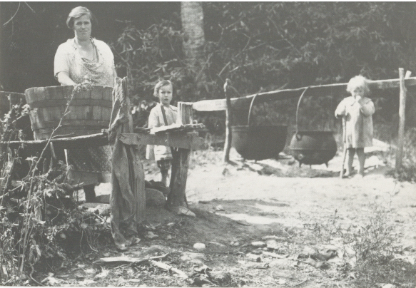
Artifact Three

Slide 18
Wash Day Meant Work Day
Wash day in the mountains meant hard work; lifting big buckets of water, tending a fire, and stirring steaming kettles of dirty clothes.
Women were also responsible for spinning yarn, churning butter, stitching quilts, cleaning house, tending the garden, sewing clothes, canning food, making soap, raising children, and other recreational pursuits.
The little girl on the right was one of the last children to be born in Cataloochee before it became part of the Great Smoky Mountains National Park.

Slide 19
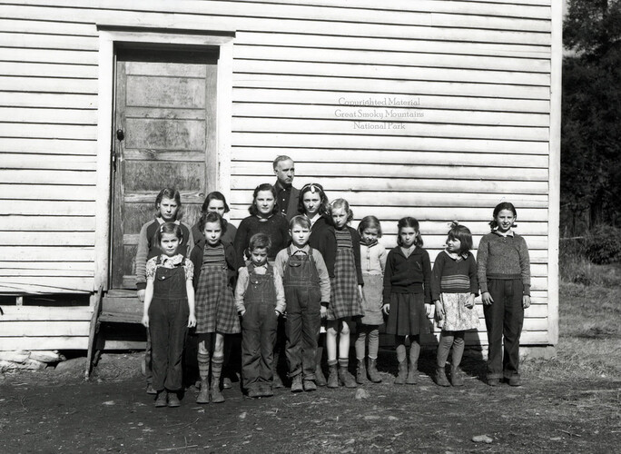
Cataloochee
Cataloochee was a remote valley in the Great Smoky Mountains that was home to a small community of farmers and homesteaders. The families who lived in Cataloochee were largely self-sufficient and relied on farming, hunting, and fishing to survive.
However, when the Great Smoky Mountains National Park was established in the 1930s, the government began acquiring land in the area, and the residents were eventually forced to leave their homes.
This photograph is of students of the Cataloochee School in the Cataloochee section of Haywood County, North Carolina. Their teacher is identified as Mont M. Hannah. The photograph was made by Hiram Coleman Wilburn (1880-1967), unofficial historian of the Great Smoky Mountain National Park. c.1937

Slide 20
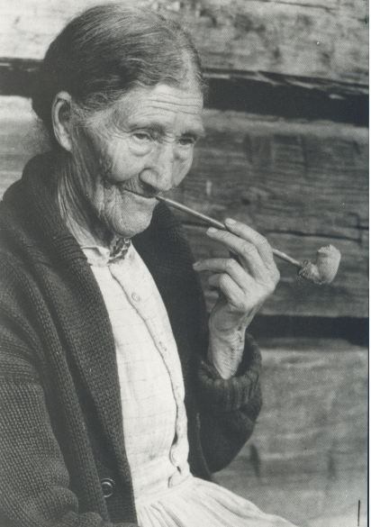
Artifact Four

Slide 21
Aunt Sophie
Sophie Brown Campbell, also known as "Aunt" Sophie, was a prominent figure in the Cataloochee Valley of the Great Smoky Mountains. She was born in 1874 and lived her entire life in the valley, where she became a beloved member of the community.
Aunt Sophie was known for her warmth, humor, and kindness, and she was also a skilled midwife and herbal healer. She delivered many babies in the valley, and her knowledge of local plants and their medicinal properties made her a respected and trusted figure among her neighbors.
There was no road to Aunt Sophie’s house, but lots of folks were willing to make the hike there anyway, just to visit with her and to buy the clay pipes and bowls she made.
When the Great Smoky Mountains National Park was established in the 1930s, Aunt Sophie and many other residents of Cataloochee were forced to leave their homes. Aunt Sophie moved to nearby Maggie Valley, where she continued to practice midwifery and herbal healing. She became known as a folk healer and was sought out by people from all over the region for her remedies and advice.

Slide 22
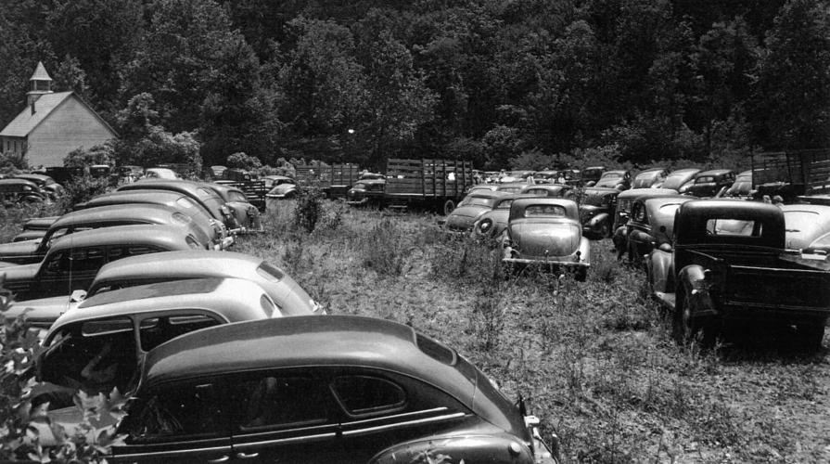
Aunt Sophie Reunions
In the 1940s, Aunt Sophie returned to Cataloochee for a visit and was greeted by a large crowd of former neighbors and admirers. The event inspired an annual reunion of Cataloochee residents, which became known as the "Aunt Sophie Reunion." The reunions continued for many years, and Aunt Sophie was always the guest of honor, celebrated for her contributions to the community and her legacy as a healer and midwife.
Aunt Sophie passed away in 1962, but her memory lives on in the Great Smoky Mountains National Park and in the hearts of those who knew her.
PARKING — There is plenty of parking area in open meadows at Cataloochee when reunion time comes around, as is shown in this 1947 file photo from The Mountaineer Newspaper.

Slide 23
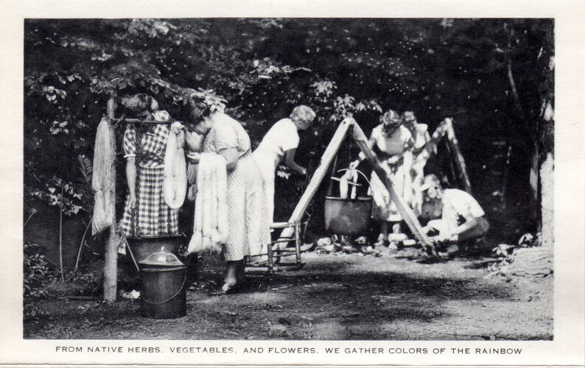
Folk Arts and Their Preservation
The goal of preserving and promoting the legacy of traditional Appalachian crafts and culture, like those practiced by Aunt Sophie and her contemporaries, lead to the founding of the John C. Campbell Folk School in 1925 in Brasstown, North Carolina.
The school's founders, John and Olive Campbell, believed that by teaching people traditional skills like weaving, woodworking, and blacksmithing, they could help to preserve the region's unique cultural heritage.
Today, the John C. Campbell Folk School is a renowned center for lifelong learning, attracting students and instructors from all over the world to study traditional crafts, music, and art.
This postcard, titled "From native herbs, vegetables, and flowers, we gather colors of the rainbow", is part of a promotional packet of postcards was produced by the John C. Campbell Folk School upon its twenty-fifth anniversary in 1950.

Slide 24
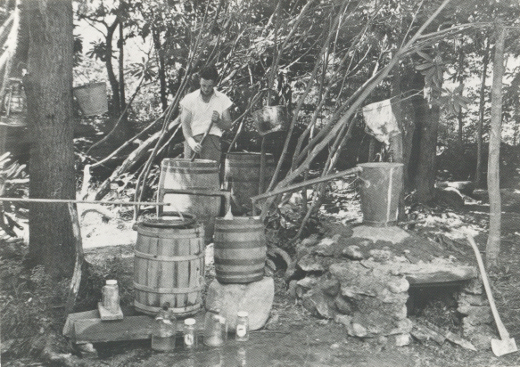
Artifact Five

Slide 25
Moonshining
Moonshining was important to people in western North Carolina because it helped them make money and support their families. In the mountains, it can be hard to grow crops and make a living, so some families made moonshine to sell and make extra money.
Making moonshine was also a part of their cultural heritage. It was something that their parents and grandparents had done, and they took pride in doing it too.
The government had made it illegal to make and sell alcohol, but some people in the mountains didn't think it was fair. They wanted to be able to make and sell their own alcohol because they saw it as a necessary and important part of their way of life.

Slide 26
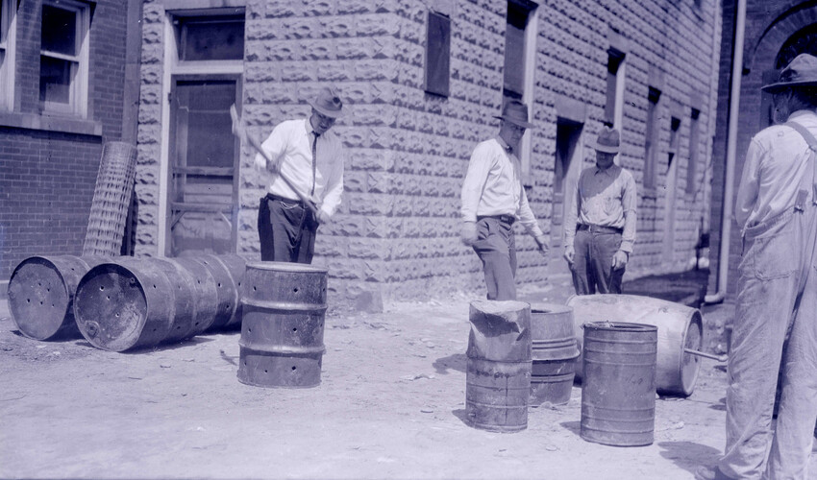
Prohibition
Prohibition was a law that made it illegal to sell or drink alcohol in the whole country. This law made it very difficult for people who made moonshine, which is an illegal alcohol, in the Smoky Mountains to continue their business.
Moonshiners had to work very hard to hide from the police and could be punished if they were caught. However, because alcohol was in high demand, some families were still able to make money by selling moonshine, even though it was illegal.
This image of men poking holes in whiskey barrels at the Bryson City jail was taken by “Doc” Kelly Bennett (1890-1974).
During the time of Prohibition, revenue agents were particularly focused on catching moonshiners and stopping the production and sale of illegal alcohol. Revenue agents would often conduct raids on moonshine stills in order to confiscate the alcohol and arrest anyone involved in the production or sale of moonshine. The job of a revenue agent could be dangerous, as moonshiners would often resist arrest and fight back against the agents.

Slide 27
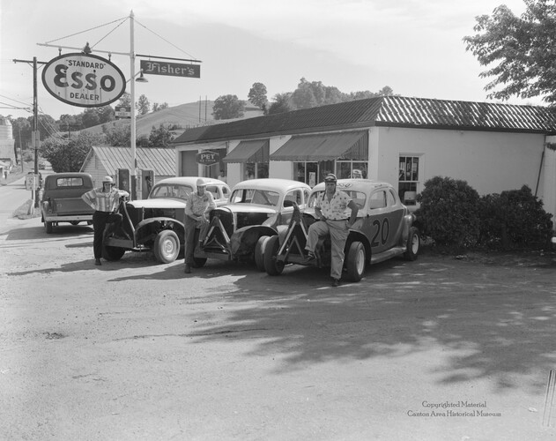
Stock Car Racing
Because moonshining was illegal, moonshiners needed to be able to transport their products quickly and safely, without getting caught by law enforcement officers. To do this, they began modifying their cars to make them faster and more powerful, allowing them to outrun the police.
After Prohibition ended in 1933, moonshiners continued to modify their cars and race them against each other in the hills and back roads of North Carolina. These races became more organized over time, and eventually gave rise to what we now know as NASCAR, a professional stock car racing organization that is headquartered in North Carolina.
This undated photograph shows stock cars sponsored by Fisher’s Esso Gas Station on Highway 110 in Canton. The far left driver pictured here is Jim Long with his number 50 racing car.

Slide 28
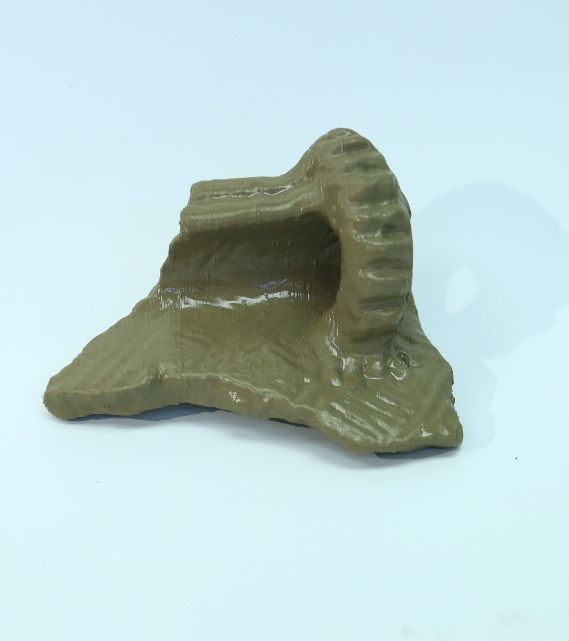
Artifact Six

Slide 29
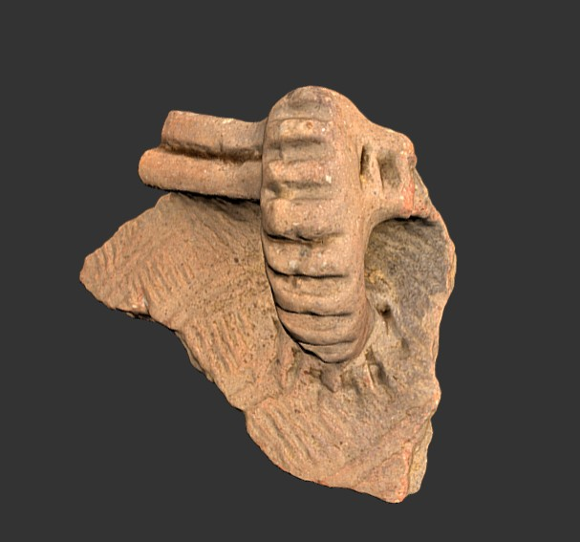
Pottery Rimsherd
Location: Birdtown mound (31Sw7), Swain County, North Carolina.
Period: Mississippian, Pisgah phase (AD 1000-1400)
Material: ceramic.
A rim sherd is a fragment of pottery that was broken off of the rim of a pot or other vessel.

Slide 30

Why is this artifact significant?
Pottery was an important aspect of Cherokee culture in Western North Carolina around 1000 AD.
The Cherokee people used pottery for a variety of purposes, including cooking, storing food, and ceremonial practices.
The production of pottery also played a crucial role in the economy of Cherokee communities, as it allowed them to trade and exchange goods with other tribes.
Pottery-making skills were passed down from generation to generation and were highly valued in Cherokee society.
Overall, pottery was an essential part of Cherokee life and culture, both for practical and symbolic reasons.
This undated blackware pottery vase was made by Mabel Bigmeat Swimmer. Mabel was raised on Wrights Creek in the Painttown community of Cherokee, North Carolina and was a third-generation potter.

Slide 31
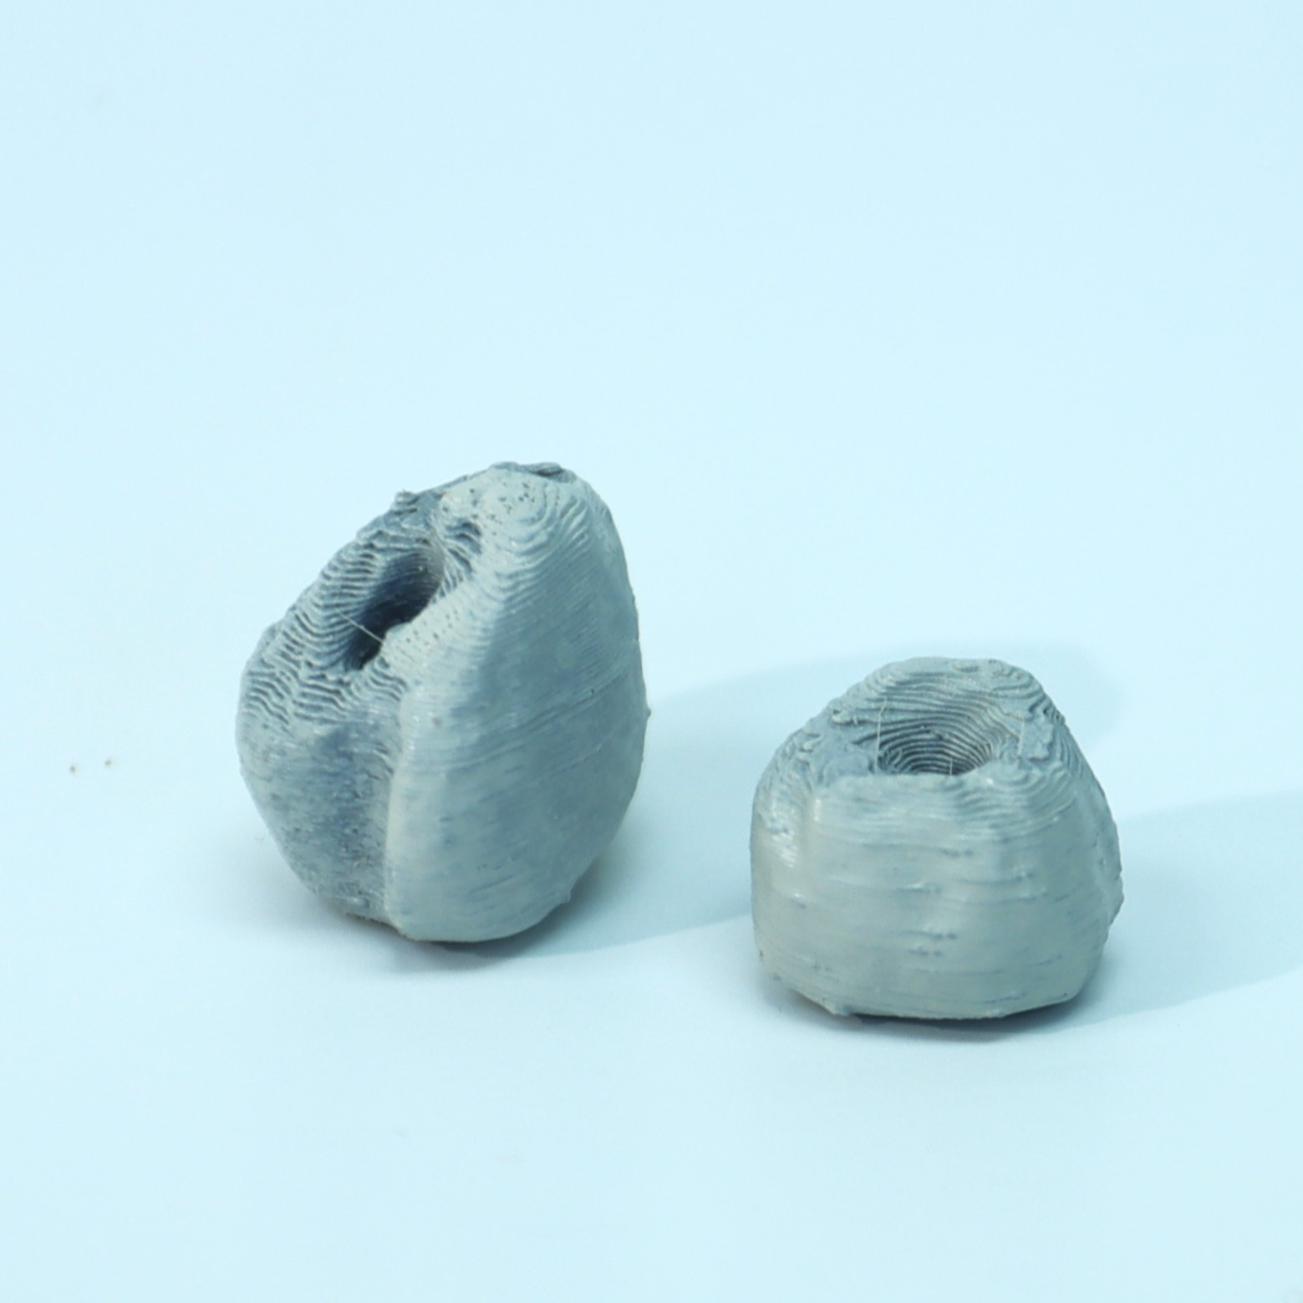
Artifact Seven

Slide 32
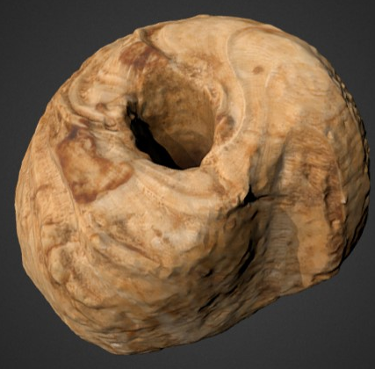
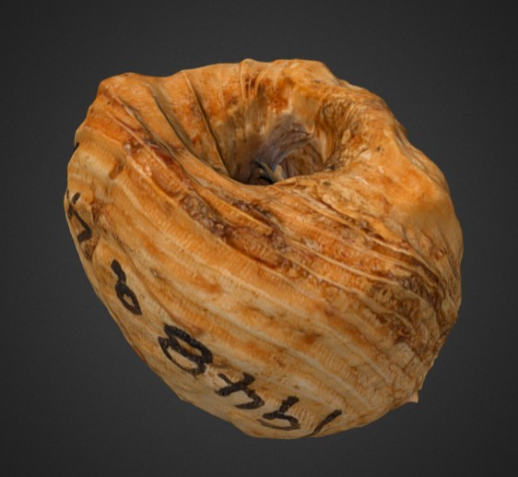
Columella Shell Beads
Location: Sellers site (31Cy42), Clay County, North Carolina.
Period: Mississippian, Qualla phase (AD 1400-1600).
Material: marine shell.

Slide 33
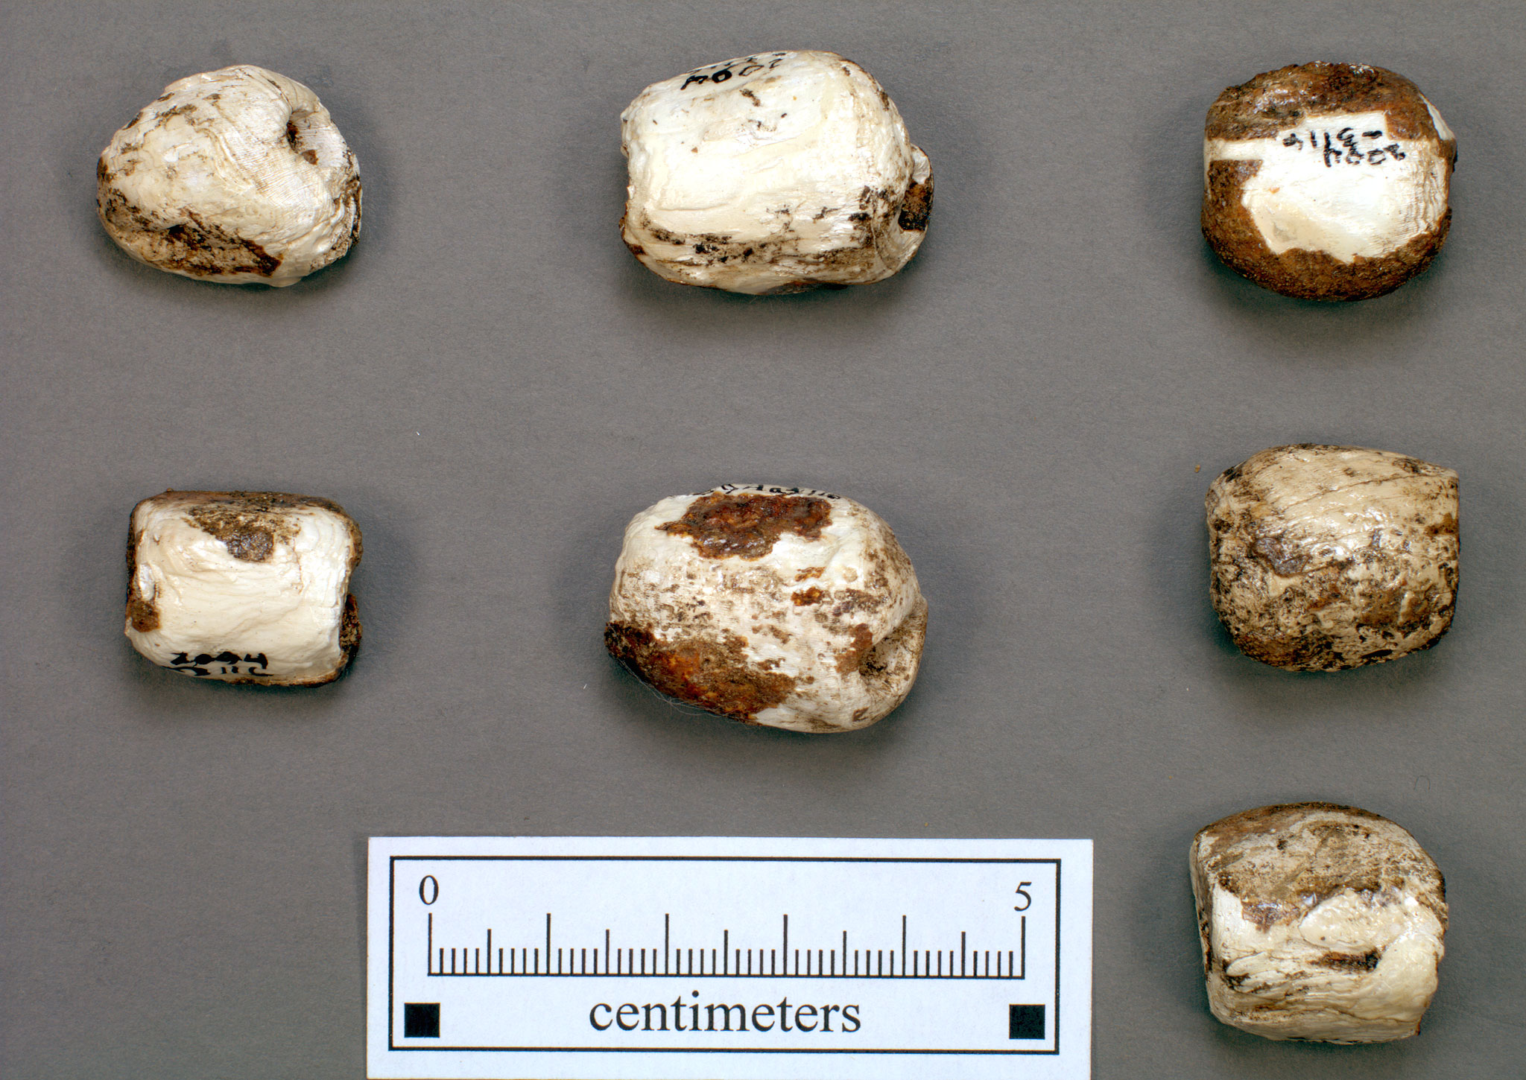
Why is this artifact significant?
Shell beads were highly valued by Cherokee Indians living in Western North Carolina around 1000 AD.
These beads were made from shells found along the coast and were used for trade and as a form of currency.
Shell beads were also used in ceremonial and decorative contexts, with intricate beadwork often incorporated into clothing and jewelry.
Additionally, the production of shell beads provided an important source of income and employment for Cherokee communities.
Overall, shell beads played a significant role in Cherokee culture and were highly prized for both their practical and symbolic value.
Columella shell beads from the Warren Wilson site in Buncombe Co., NC

Slide 34
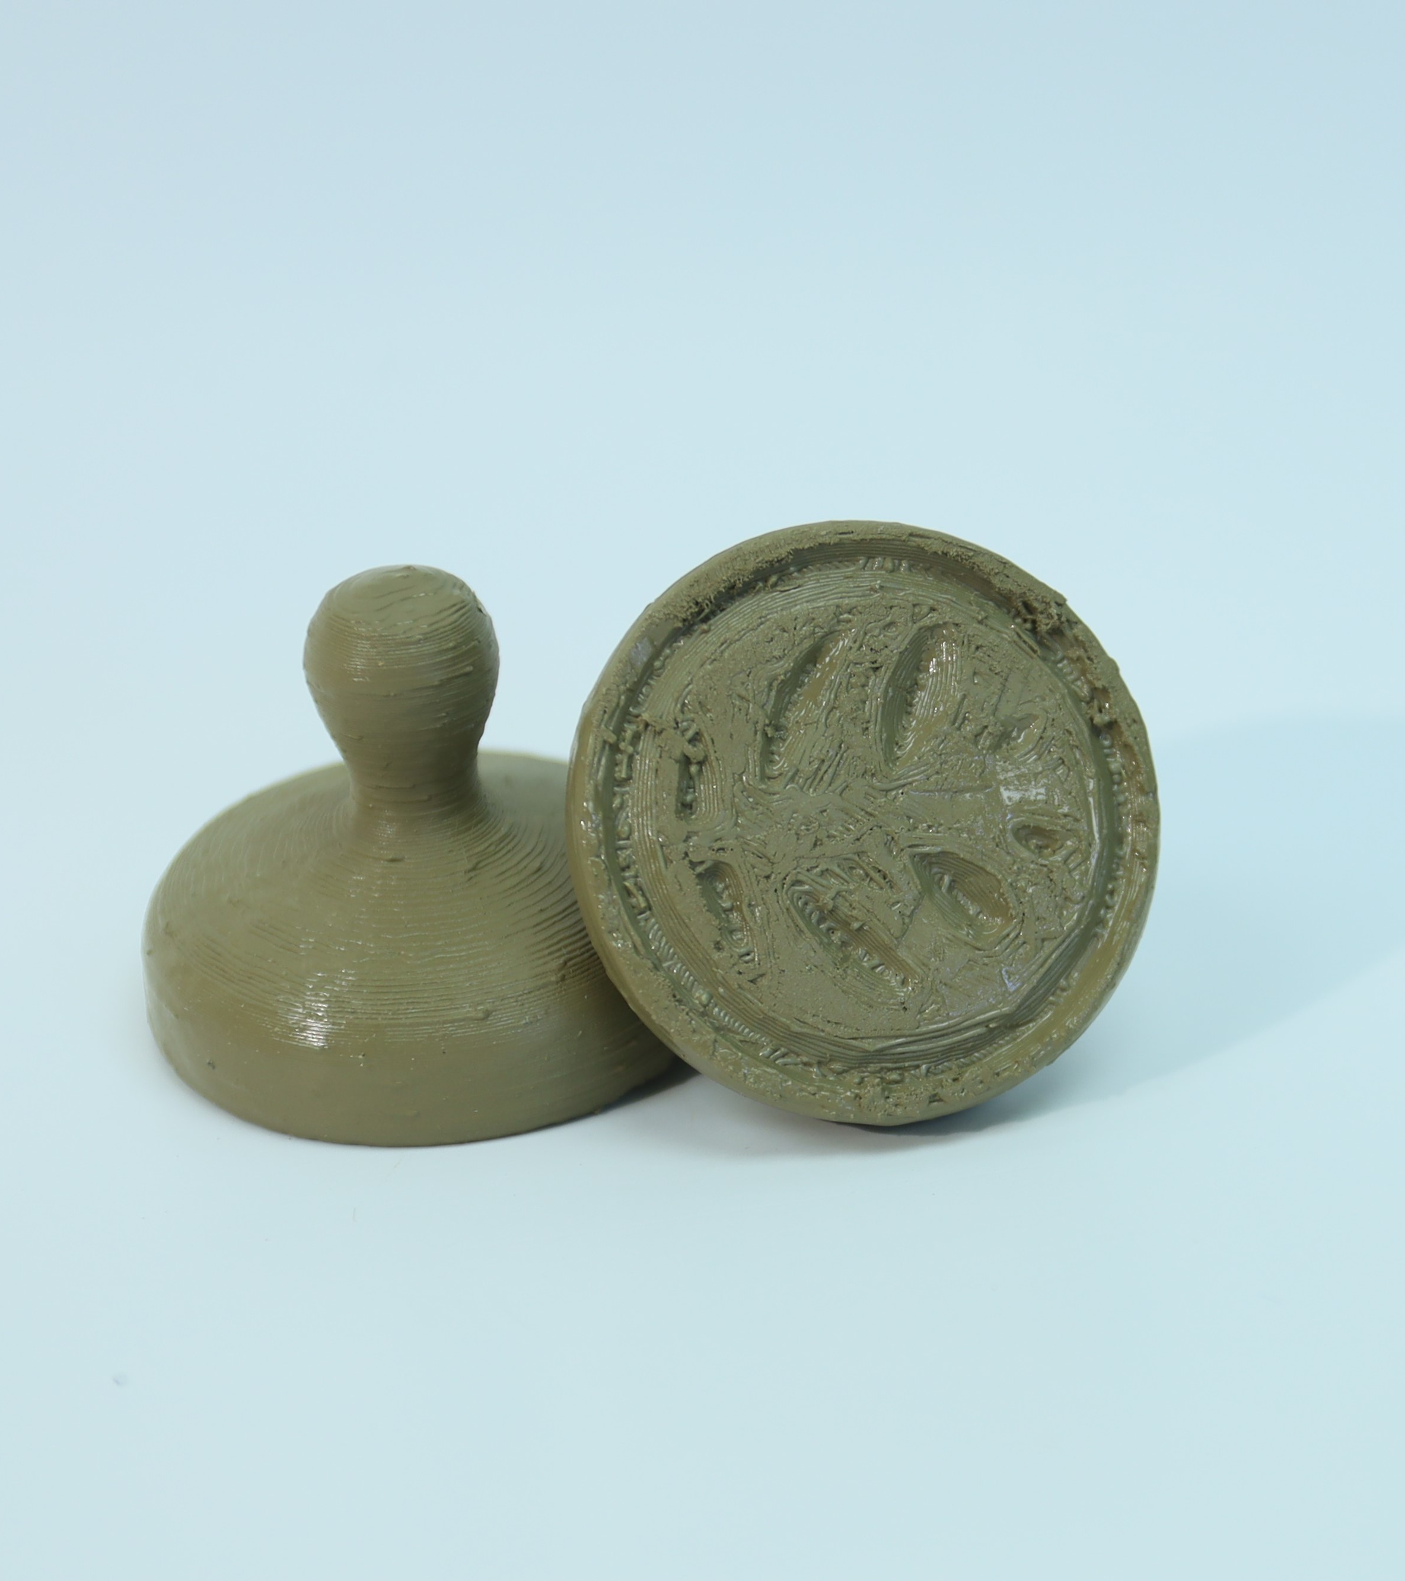
Artifact Eight

Slide 35
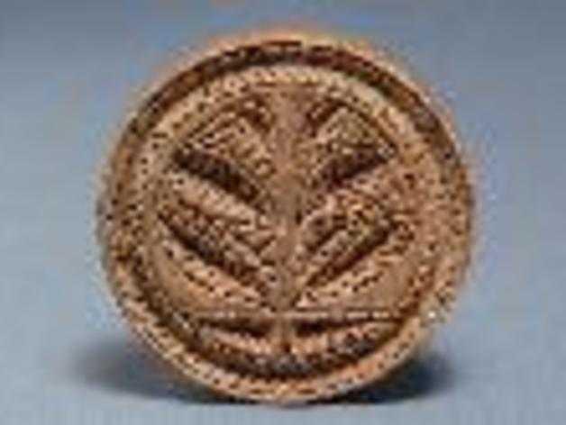
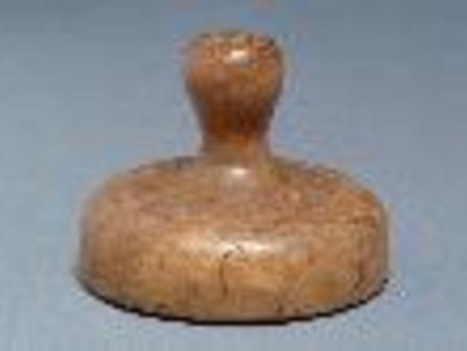
18th Century Butter Print
This butter print was made in the late 18th century, and the hand-carved design appears to be a tobacco plant. The exact origins and uses of this butter print are unknown, but the artifact represents the importance of butter-making and growing tobacco on rural farms in early America.
Tobacco farming was an important industry in Western North Carolina during the late 1800s and early 1900s.
The region's favorable climate and fertile soil made it an ideal location for growing tobacco, which became a major cash crop for local farmers. The tobacco industry helped to support the local economy, providing jobs and income for many families in the area.
However, tobacco farming also had negative effects, including environmental degradation and health risks associated with smoking.

Slide 36
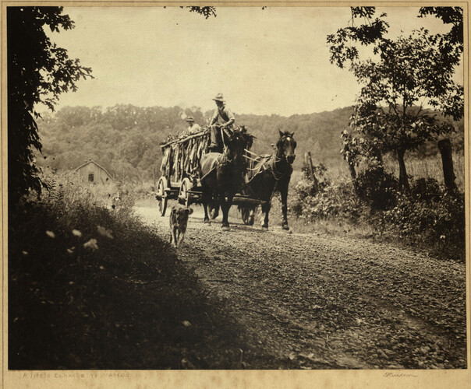
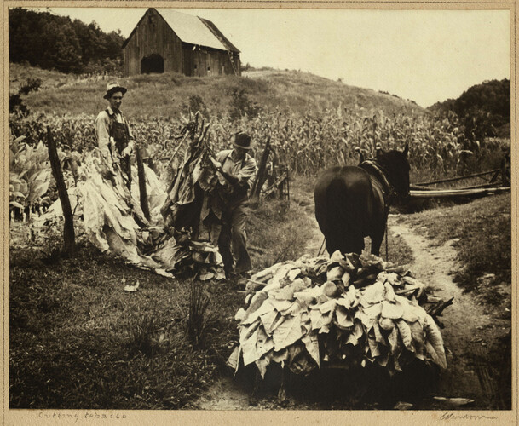
Hauling and cutting tobacco
These photographs were taken by Edgar S. Purdom. Born in 1900, Purdom opened a custom furniture shop in Wayah Valley, near Franklin, NC, in 1946. He was a hobby photographer and made these photographs in Western North Carolina. Purdom retired in 1968 and passed away in Lake County, Florida in 1987.

Slide 37
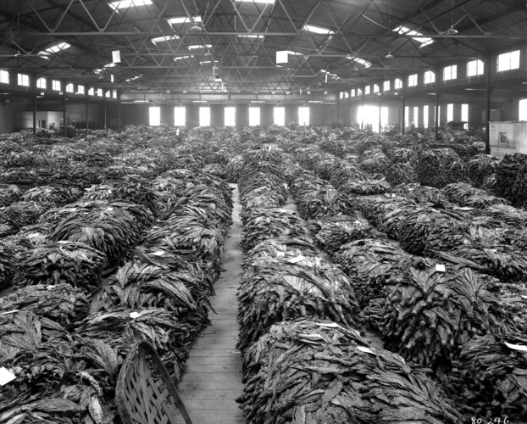
Tobacco, entire warehouse floor filled.
Interior of the B.B. Saunders Tobacco Warehouse in Asheville filled with piles of tobacco. One story building with high ceilings.
Tobacco provided money for many families in Western North Carolina, including families in Haywood County. Not all farmers grew a large amount, some farms only grew enough to make extra money for things like Christmas presents.

Slide 38
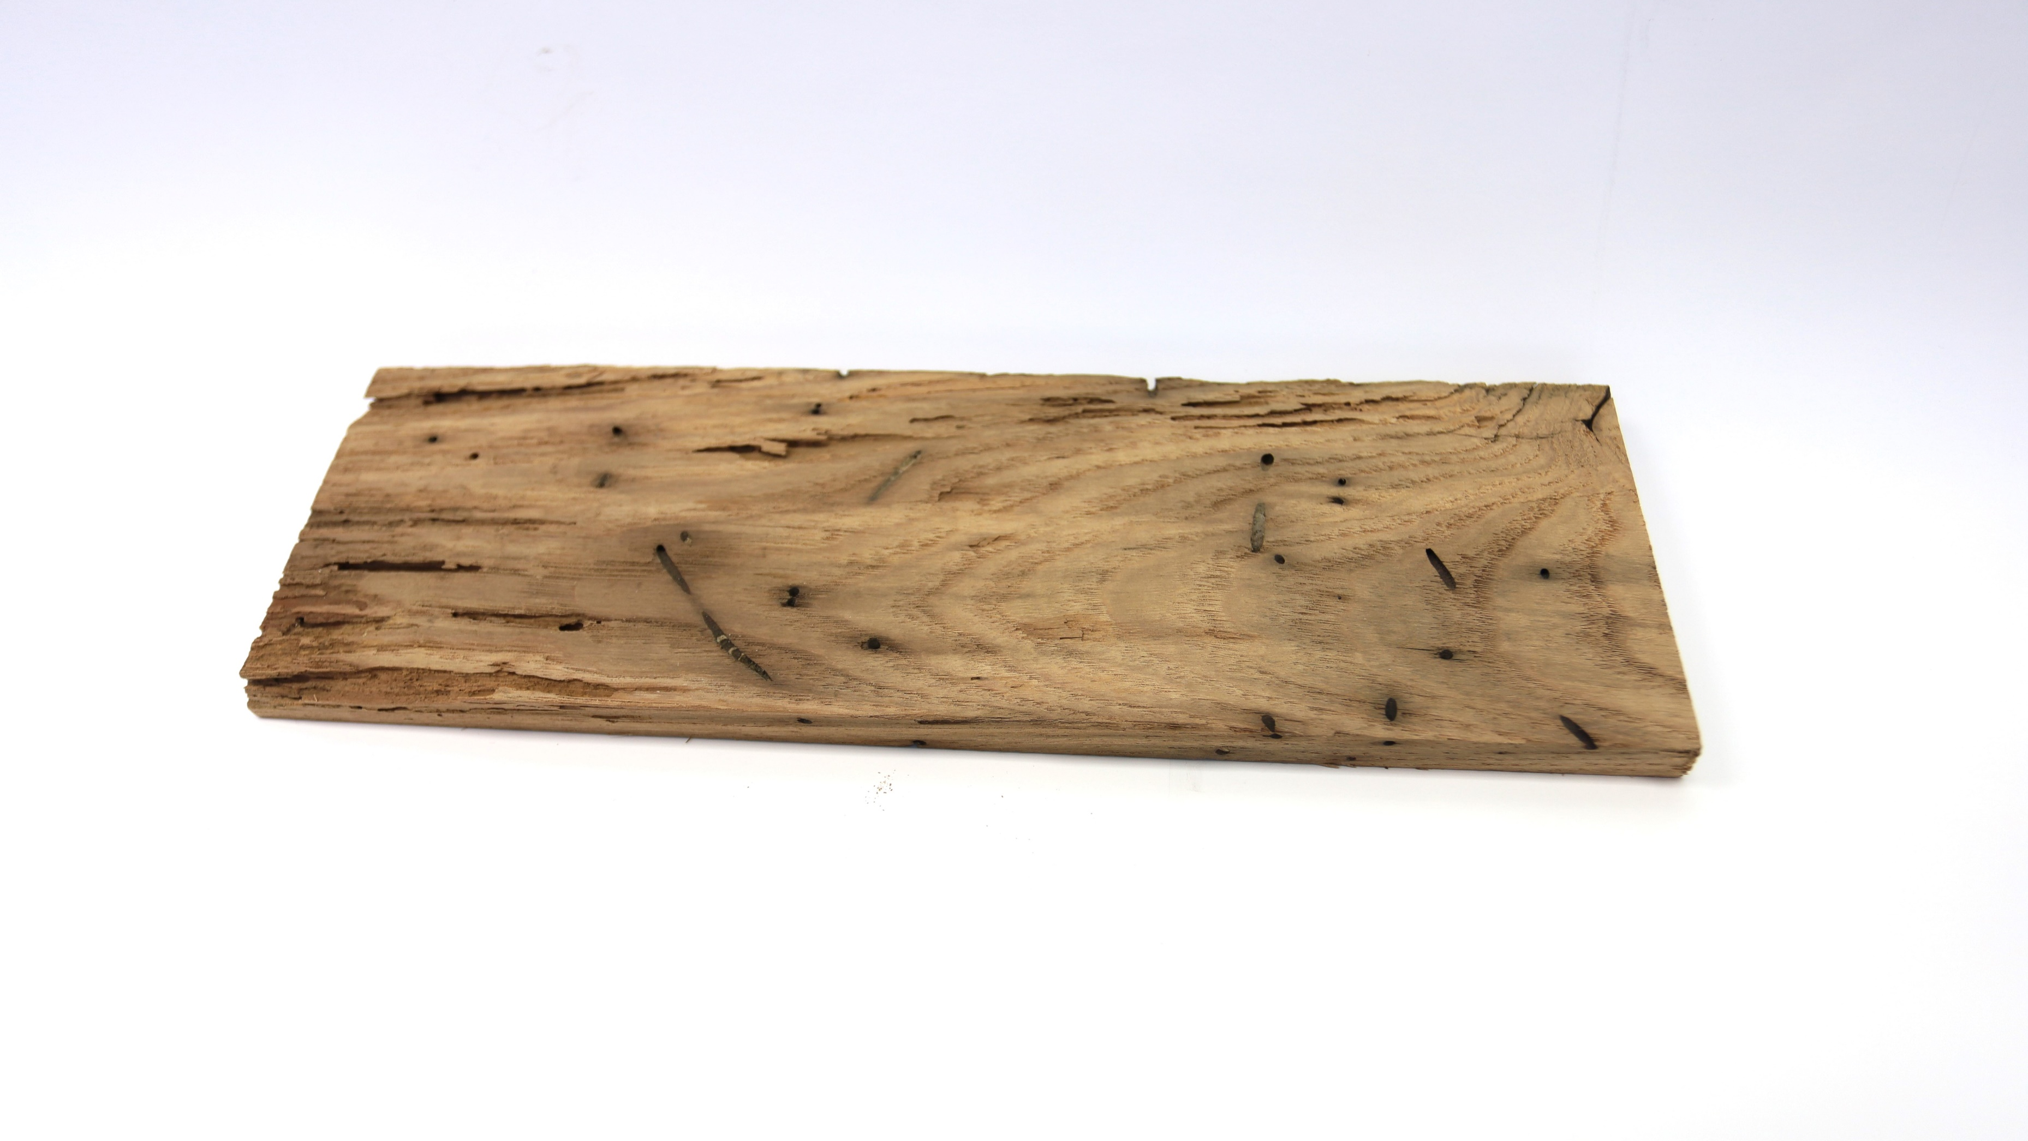
Artifact Nine

Slide 39

Wormy Chestnut
Before the introduction of the chestnut blight in the early 20th century, American chestnut trees dominated forests of the eastern United States. Known as the “redwood of the East,” the tree often reached towering heights of 150 feet. Experts estimate that at one time, one in every four hardwood trees in the East was an American chestnut.

Slide 40
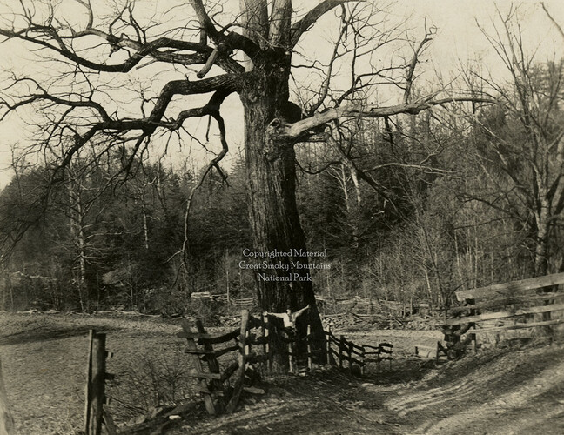
By the 1950s, the blight had killed billions of trees and left the species virtually non-existent. Today, any chestnuts found in the Eastern forests never grow beyond a few feet tall and rarely flower. Chestnut trees have reached a “genetic dead-end” in the United States because of their inability of reproduce.
This photograph of a chestnut tree was taken on "Huse" Lawson's farm in Wears Cove. This photograph, with others in this series, are included in the records of the Smoky Mountains Hiking Club, formed after a group of outdoor enthusiasts hiked up to Mount LeConte in October 1924. The photographer is unknown. The back of the picture is stamped “Jim Thompson Co.,” indicating it was probably printed by hiking club member James E. (Jim) Thompson (1880-1976).

Slide 41
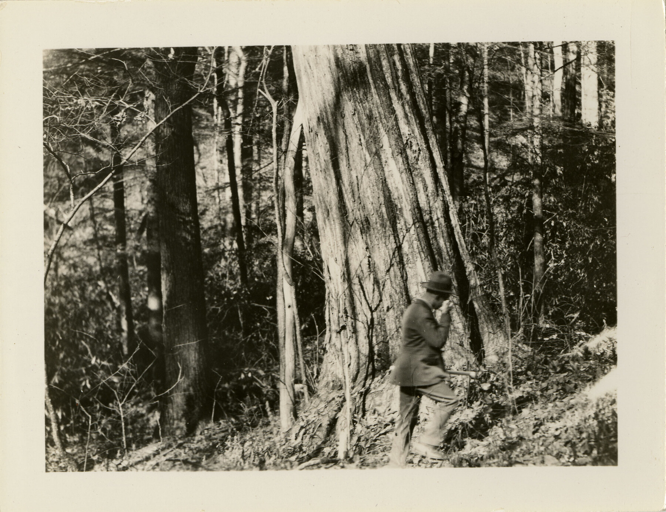
Why were chestnut Trees significant?
“The chestnut was important for both the forest ecosystem and human use for several reasons. Its nuts were a valuable food source for both animals and people. It was resistant to most diseases and wood rot, and its wood was easy to work with for loggers.”
- Barbara Crane, Ph. D., USFS
Photographer: Wells, B. W. (Bertram Whittier), 1884-1978

Slide 42

Wormy Chestnut Wood Today
Wormy chestnut is called "wormy" because it has been infested by the larvae of the chestnut bark beetle, which leaves characteristic holes and tunnels in the wood. While the infestation does not harm the wood's strength or durability, it gives the wood a unique appearance that many people find attractive.
Because wormy chestnut is rare and has a distinctive appearance, it can be expensive to purchase. The wood is often used for high-end furniture, flooring, and decorative accents. Additionally, because it is no longer possible to harvest new wormy chestnut from living trees, the existing supply is limited, which can also contribute to its high price.

Slide 43
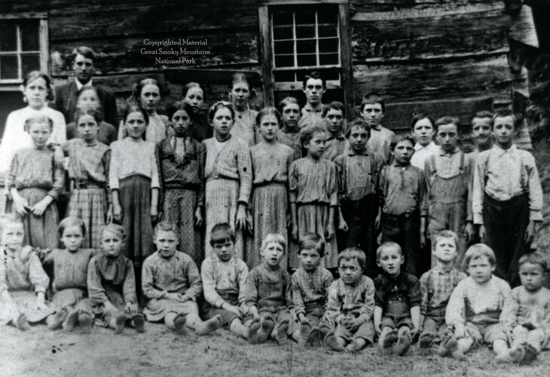
Reflection
On your paper:
3- Tell me three things you found interesting
2 - Tell me to things you learned
1- Tell me one question you still have
In this photograph, circa 1914, students of Baskins Creek School and Little Valley Church pose with their teacher, Lewis Clabo.

